Slide 1
E-book Reader
A BPC/PP2 Project
By BenjoBoys – Jiří Navrátil, Tomáš Kříčka

Slide 2
Description
This E-book Reader is able to read .txt, .pdf and .epub file formats
It can be also used as a text editor/notepad saving as a .txt
Program made in 243 lines of code with comments in 1 python file
Includes testing files in said formats

Slide 3
Used libraries
Tkinter
PyMuPDF
Os

Slide 4
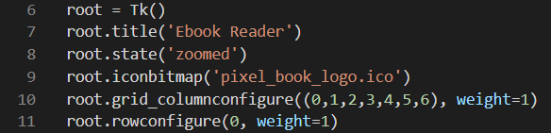
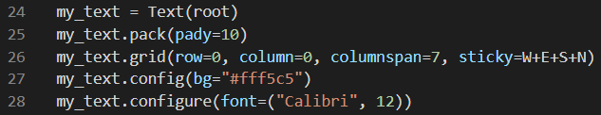
Initial GUI setup
Here the header is named and the grid of individual components (textbox, buttons, etc.) is structured
Textbox is created as shown with expandable/retractable sides that stick to the program window itself

Slide 5
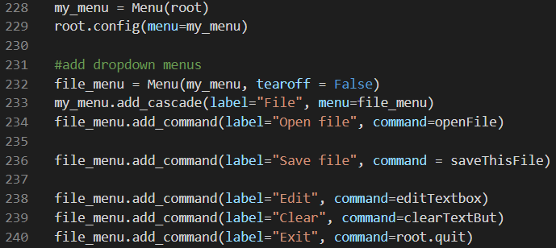
Initial GUI setup
A file dropdown menu with different functions is made here

Slide 6
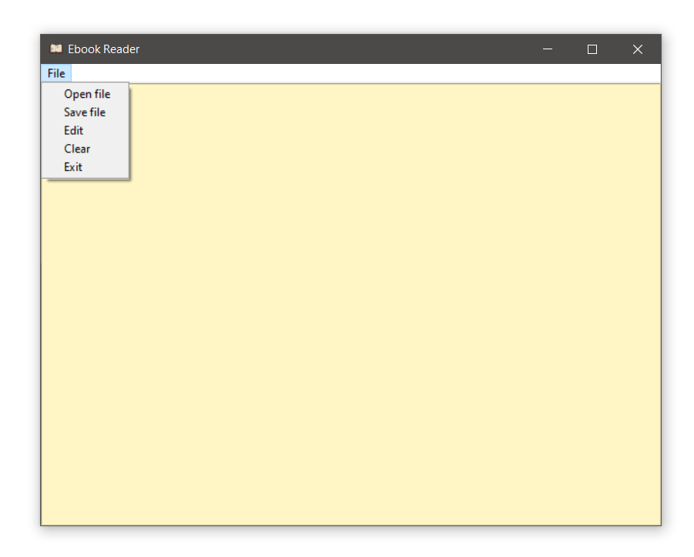
Initial GUI setup

Slide 7
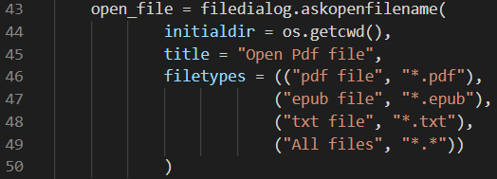
Main function
The whole program is based around the open_file() function where the user selects desired file, he wants to be presented, with a filedialog
After selection, the buttons and page counter are created

Slide 8
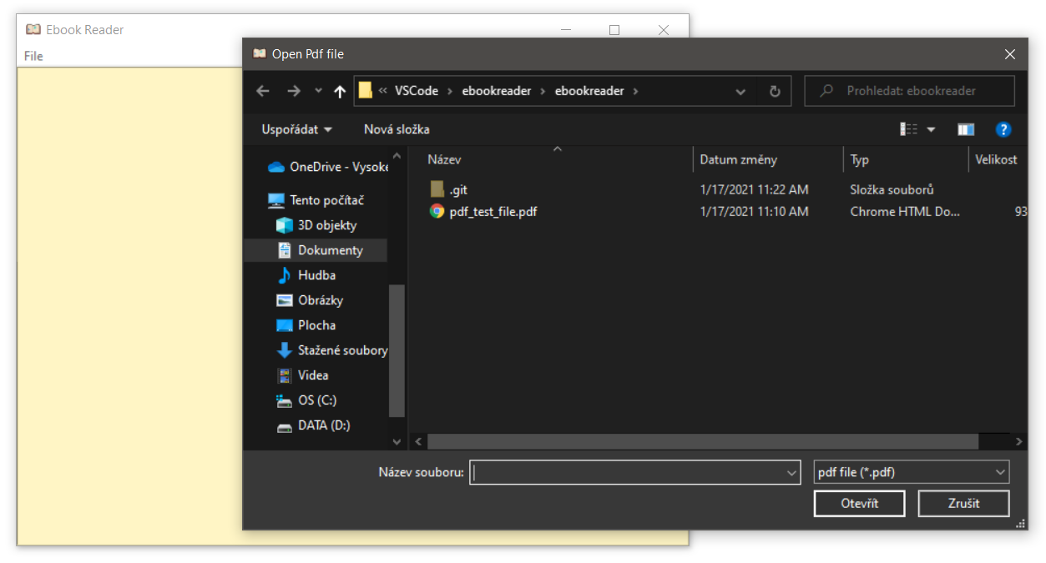
Main function

Slide 9
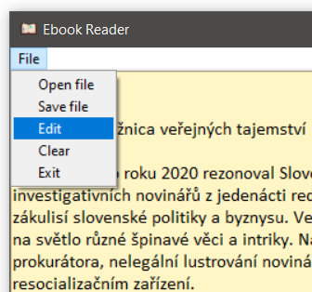

Editing
As was mentioned earlier, you can edit currently viewed page of an opened file
The editing feature must be enabled as it is disabled initially after opening any file

Slide 10
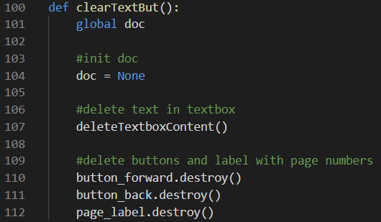
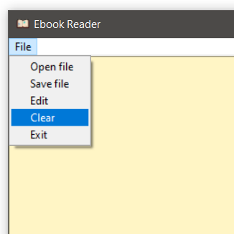
Clearing
If the user wants to use the program as a notepad but has a file opened, a simple clear function can be called to get rid of any text and unnecessary buttons and labels

Slide 11
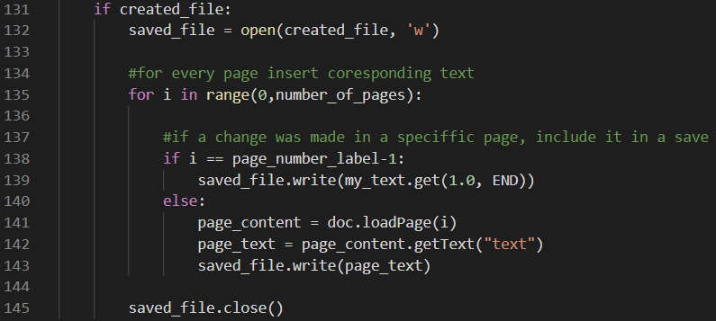
Saving
After the user edits his parts of a text, it can be saved as a .txt file with the changes made on the specific page

Slide 12
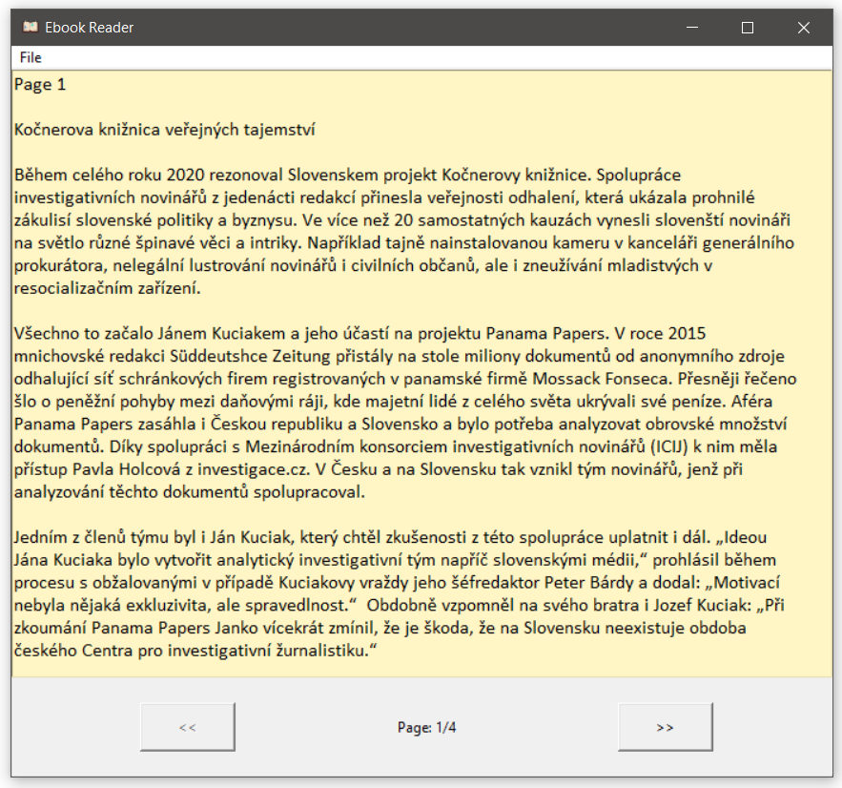
Example

Slide 13
Problems
A scrollbar is not included
Words cut in the middle when the window is small enough to do so
.pdf and .epub files with only 1 page don’t set the page counter correctly
Only 3 file formats are supported (.pdf, .epub, .txt)
Saving in only .txt format

Slide 14
Collaboration between programmers
For communication we used Discord
Work was done through Live Share module in Visual Code
Files themselves were transferred with GitHub’s Desktop app

